Slide 1
That takes the BISCUIT!
A comparative study
of predictive accuracy and interpretability
of four statistical learning techniques
in personality data,
with data missingness conditions
Lorien G. Elleman

Slide 2
Overview
What is statistical learning (SL)?
One way SL can be applied to personality.
Introducing a new SL technique: BISCUIT!
Three other SL techniques in this study.
Methods, results, and conclusions.

Slide 3

What is statistical learning (SL)?

Slide 4
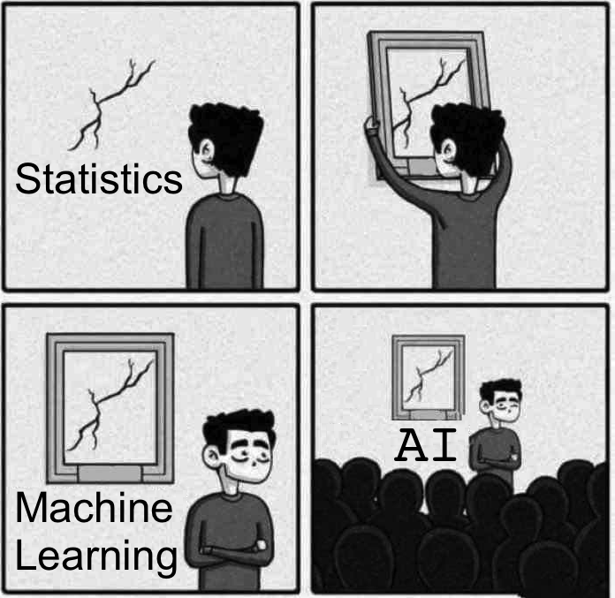
What is statistical learning (SL)?
©SandSerif

Slide 5
What is statistical learning (SL)?
“A set of tools for modeling and understanding complex datasets” (James, Witten, Hastie & Tibshirani, 2017, p. 1).
Generally, SL techniques are more complex than traditional methods of analysis (e.g., regression).
Some SL techniques modify those traditional methods.
Most SL techniques use more predicting variables.
This talk focuses on supervised statistical learning.
  For this study, that means using personality data to predict criteria.

Slide 6

Common features of SL
Sample is split into “training” and “test” data to reduce overfitting.
Sample

Slide 7
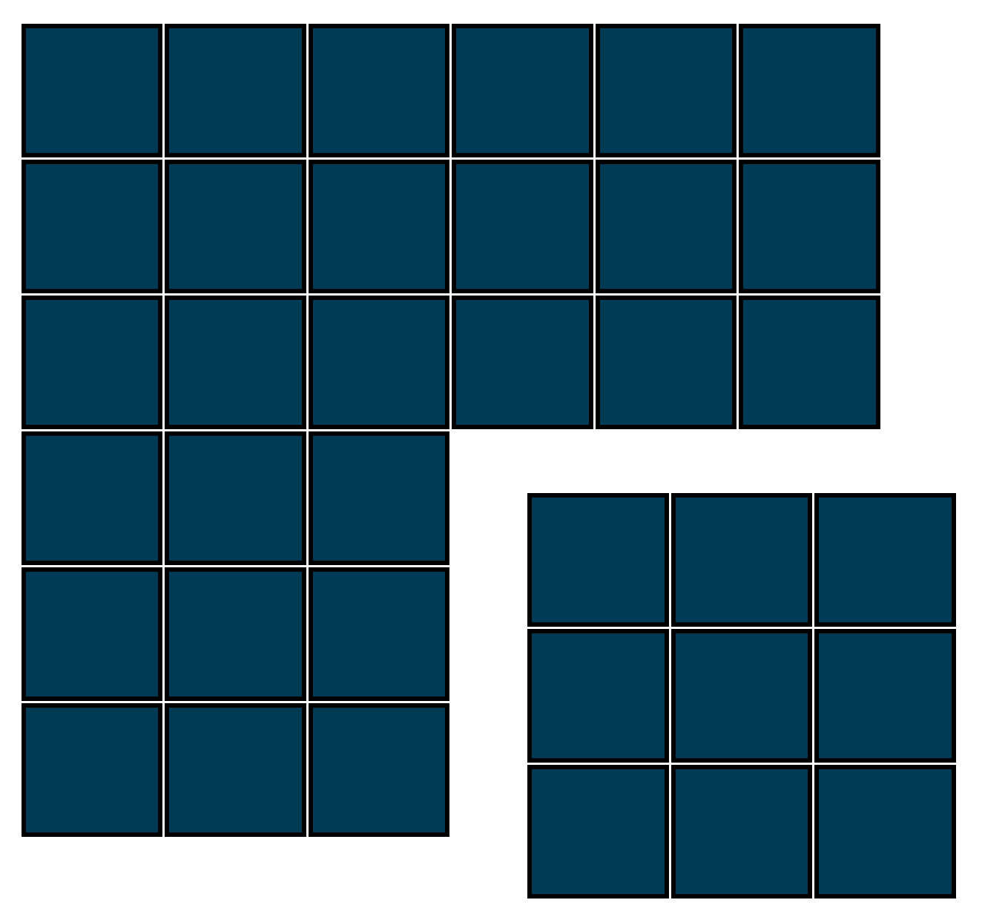
Common features of SL
Sample is split into “training” and “test” data to reduce overfitting.
  An SL model is built (trained) on “training” data.
  “Test” data serves to test the model’s predictive accuracy.
Goal: Maximize a model’s predictive accuracy of test data.
  How? By reducing model overfitting of the training data.
Training data
Sample
Test data

Slide 8
One way SL can be applied to personality
Prediction of criteria with personality “nuances” (McCrae, 2015).
  AKA, personality items
Personality items:
  Cross-rater agreement (Mõttus, McCrae, Allik, & Realo, 2014)
  Rank-order stability over time, and are heritable (Mõttus, Kandler, Bleidorn, Riemann, & McCrae, 2017; Mõttus, Sinick, et al., 2018)
  Out-predict domains (e.g., Big Five) and narrower facets (Seeboth & Mõttus, 2018; Mõttus et al., 2015; Mõttus, Bates, Condon, Mroczek, & Revelle, 2018)
But there are so many personality items!
  For traditional techniques, this leads to overfitting the data.
  SL techniques solve this overfitting problem for nuances.

Slide 9
Introducing: BISCUIT!
BISCUIT (Revelle, 2019) is an SL technique that specializes in Massively Missing Completely at Random (MMCAR) data
BISCUIT stands for:
  Best Items Scale
  (that is)
  Cross-validated,
  Unit-weighted,
  Informative and Transparent

Slide 10


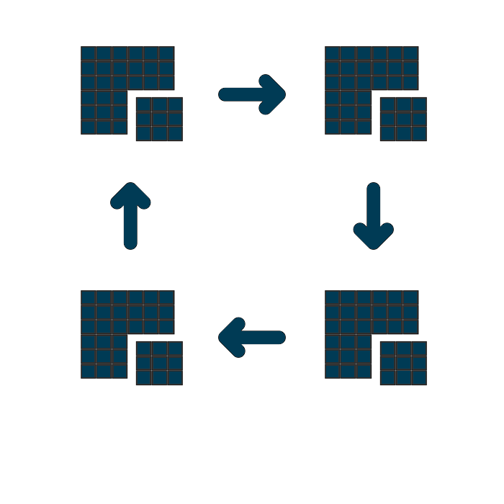

Introducing: BISCUIT!
Correlation-based
  Best Items Scale
  Finds the n items most highly correlated with a criterion.
  Quasi-regularization: unit-weighting, just like a typical scale.
  Explicit variable selection: selects the top n best items.
  Resampling: the best items are based on average
  cross-validated correlations.
  Tuning parameter: number of best items; optional.

Slide 11
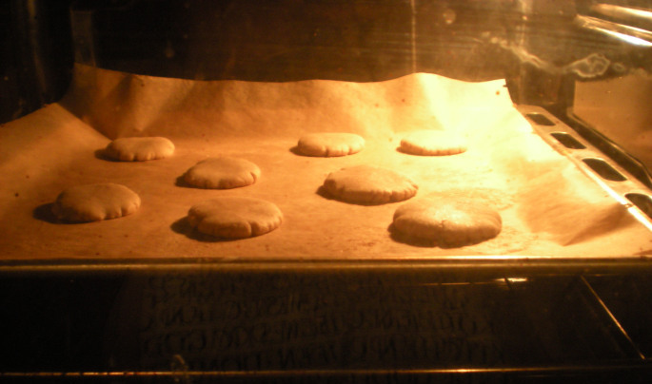
Introducing: BISCUIT!
Compared to more “black box” SL methods, BISCUIT’s results are transparent like an oven window.

Slide 12
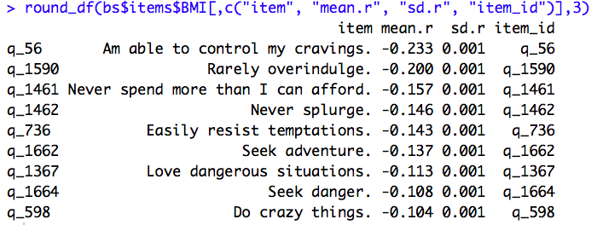
Introducing: BISCUIT!
Compared to more “black box” SL methods, BISCUIT’s results are transparent like an oven window.
BISCUIT’s short list of best items can be informative for theory-building.

Slide 13
Four other methods
Three statistical learning techniques
  Lasso (regression-based)
  Elastic net (regression-based)
  Random forest (decision tree-based)
Basic regression as a baseline
  Big Five
  SPI-27 (Condon, 2018).

Slide 14
The sample
Collected from SAPA-project.org
Complete data: 78,828 participants
  From 200 countries (57% from the U.S.)
  65% were female
  Median age = 33 years (min = 14, max = 90).
135 personality items from the SPI-27
Five criteria:
  BMI, general health, education, smoking frequency, sleep quality

Slide 15
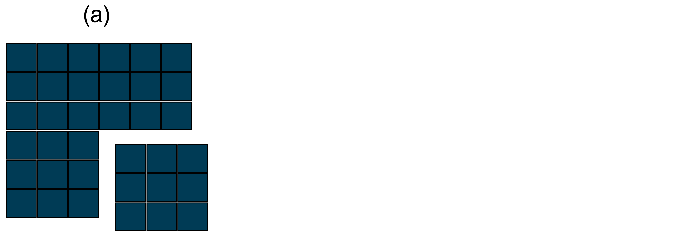
Methods: Imposed data missingness
(a) The sample (complete) was split into training and test data.

Slide 16
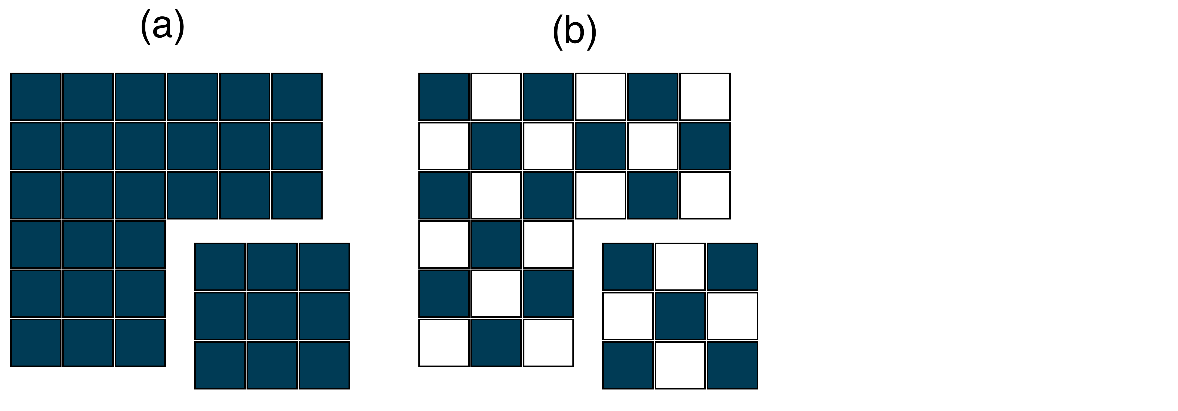
Methods: Imposed data missingness
(a) The sample (complete) was split into training and test data.
(b) Random missingness was imposed on personality data.

Slide 17
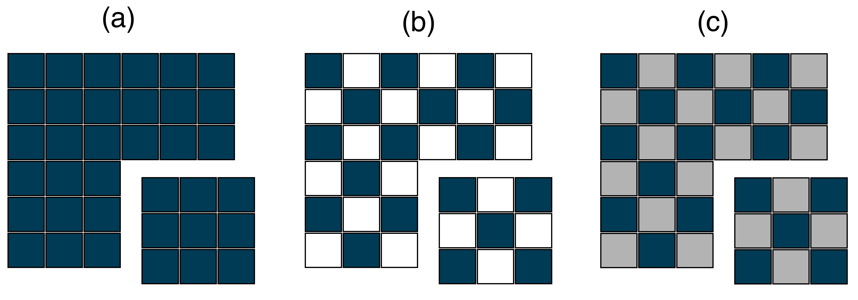
Methods: Imposed data missingness
(a) The sample (complete) was split into training and test data.
(b) Random missingness was imposed on personality data.
(c) Missing data were imputed (multiple imputation using Bayesian principal components analysis; Audigier, Husson, & Josse, 2014).
  BISCUIT used data sets with missingness (b). All other techniques used imputed data (c).

Slide 18
Expected results
BISCUIT’s predictive accuracy would be more competitive with other SL techniques at higher levels of data missingness.
  BISCUIT was designed to analyze MMCAR data.
Regression would not be a competitive technique for predictive accuracy, compared to SL techniques.
BISCUIT would generate the most interpretable models (fewest items used), compared to other SL techniques.

Slide 19
Results: Predictive accuracy

Slide 20
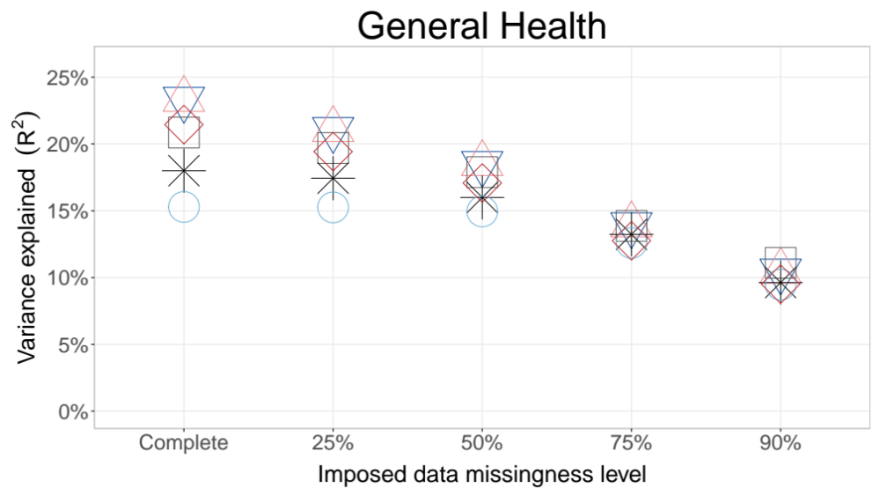
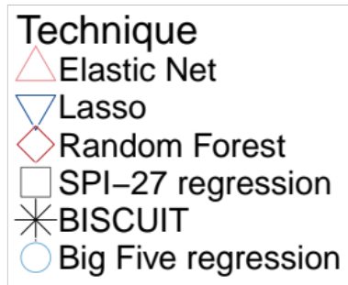

Slide 21
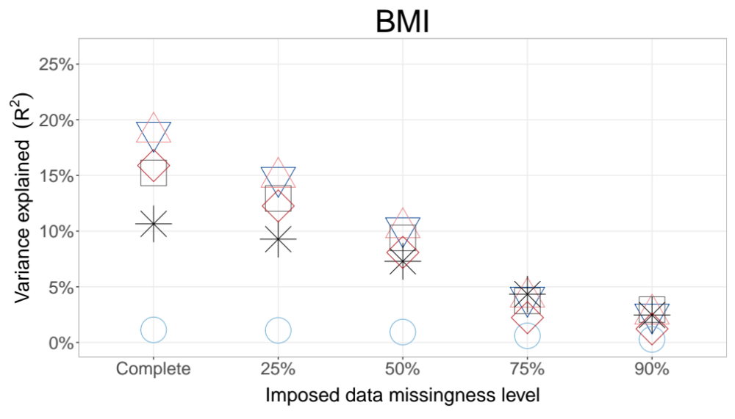

Slide 22
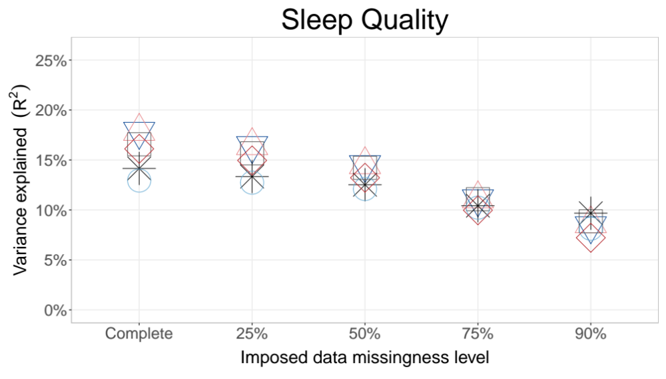

Slide 23
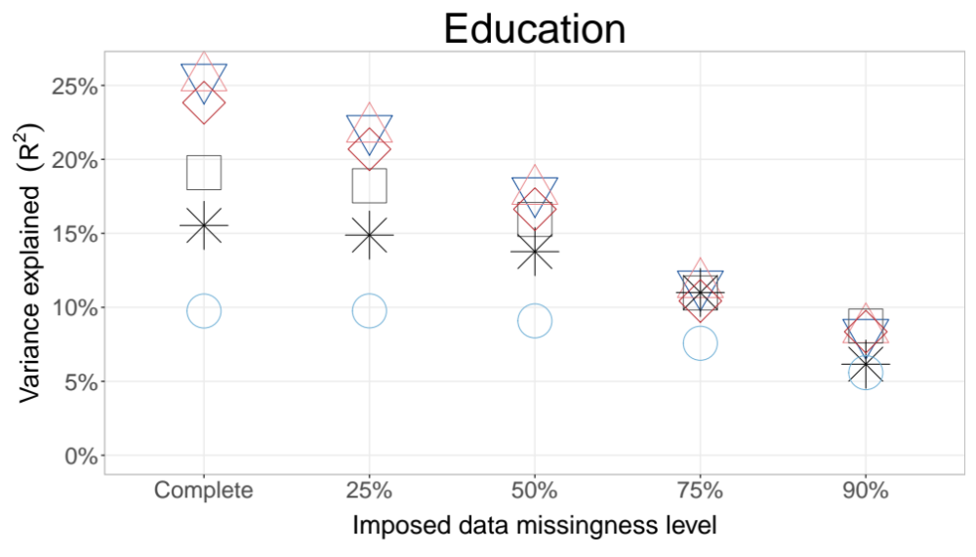

Slide 24
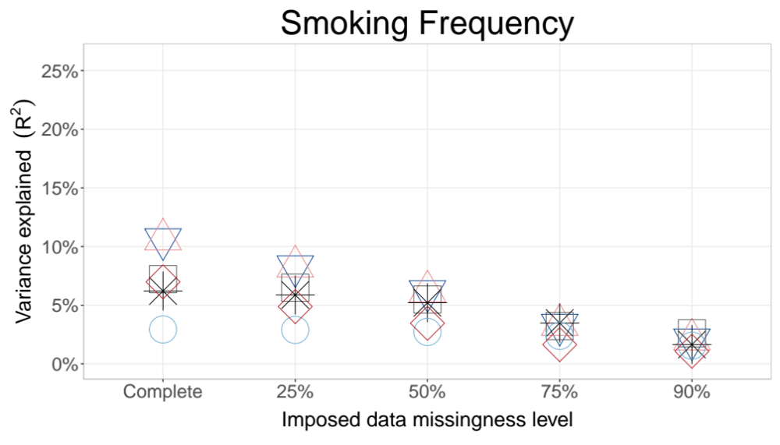

Slide 25
Predictive accuracy: Rankings (complete data)
1. Elastic net
2. Lasso (99.9% as predictive)
3. Random Forest (85% as predictive)
4. SPI-27 regression (81% as predictive)
5. BISCUIT (66% as predictive)
6. Big Five regression (42% as predictive)

Slide 26
Predictive accuracy: Elastic net and lasso
The elastic net dominated other techniques in the complete, 25% and 50% data missingness conditions.
  Across all conditions, the lasso was 99.8% as predictive.
Multiple R of elastic net with criteria (complete data):
  R_{Education} = .51
  R_{Health} = .48
  R_{BMI} = .43
  R_{SleepQuality} = .42
  R_{SmokingFrequency} = .33
Multiple R of Big Five with criteria (complete data):
  R_{Education} = .31
  R_{Health} = .39
  R_{BMI} = .11
  R_{SleepQuality} = .36
  R_{SmokingFrequency} = .17

Slide 27
Predictive accuracy: BISCUIT
BISCUIT’s relative predictive accuracy increased as data missingness increased. On average, compared to the most predictive model, BISCUIT was:
Complete data: 66% as predictive
25% data missingness: 73% as predictive
50% data missingness: 81% as predictive
75% data missingness: 97% (best models for two criteria)
90% data missingness: 81% (best model for one criterion)

Slide 28

SL Interpretability (avg. # of items used)
Notes:
1. BISCUIT: mean_{items}= 23 per model (SD = 10, range = 5-30)
Most interpretable model in 23 of 25 conditions.
2. Lasso: mean_{items}= 59 per model (SD = 27, range = 14-112)
Most interpretable model in 2 of 25 conditions.
3. Elastic net: mean_{items}= 61 per model (SD = 27, range = 15-113)
4. Random forest: mean = 135 per model.

Slide 29
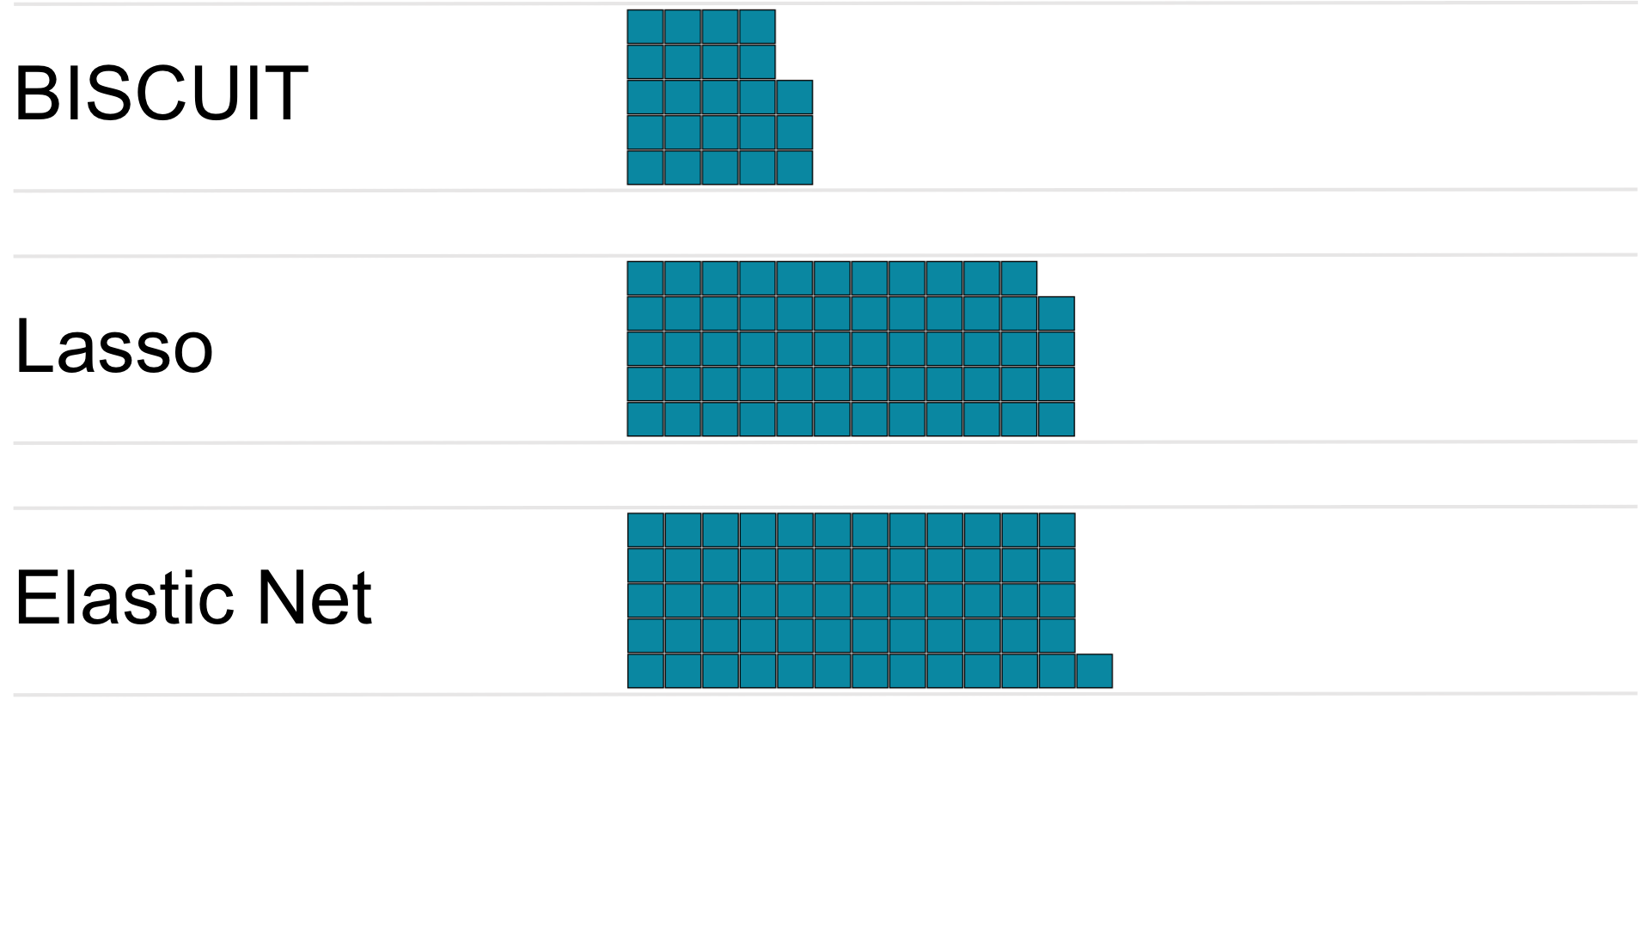
SL Interpretability (avg. # of items used)
Notes:
1. BISCUIT: mean_{items}= 23 per model (SD = 10, range = 5-30)
Most interpretable model in 23 of 25 conditions.
2. Lasso: mean_{items}= 59 per model (SD = 27, range = 14-112)
Most interpretable model in 2 of 25 conditions.
3. Elastic net: mean_{items}= 61 per model (SD = 27, range = 15-113)
4. Random forest: mean = 135 per model.

Slide 30
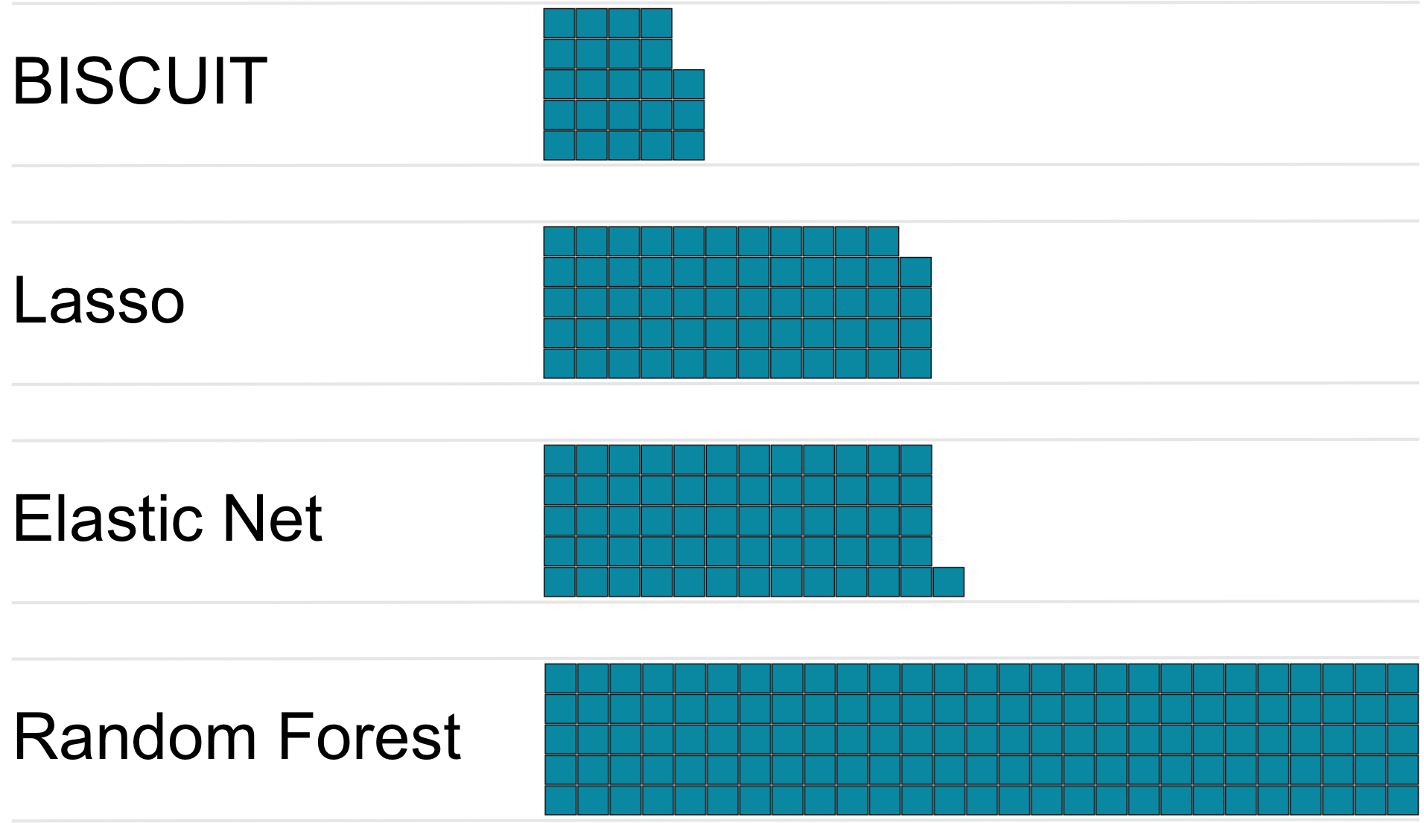
SL Interpretability (avg. # of items used)
Notes:
1. BISCUIT: mean_{items}= 23 per model (SD = 10, range = 5-30)
Most interpretable model in 23 of 25 conditions.
2. Lasso: mean_{items}= 59 per model (SD = 27, range = 14-112)
Most interpretable model in 2 of 25 conditions.
3. Elastic net: mean_{items}= 61 per model (SD = 27, range = 15-113)
4. Random forest: mean = 135 per model.

Slide 31
Conclusions
BISCUIT worked well for higher levels of data missingness, and was the most interpretable/cost-efficient SL technique.
Elastic net (or lasso) was the best choice for predictive accuracy in complete data or up to 50% data missingness.
Random forest was a competitive SL technique for predicting criteria with personality items, but was the least interpretable.
Regression using SPI-27 was a reasonable choice.
Compared to other techniques, regression using the Big Five had poor predictive accuracy.

Slide 32
Acknowledgements
Sarah McDougald
Bill Revelle
David Condon
Presentation template by SlidesCarnival
Icons from thenounproject.com
  Artists: Eucalyp; Rose Alice Design; Ralf Schmitzer, DE; Royyan Wijaya, ID

Slide 33

Thank you!
Email: LGElleman@u.northwestern.edu
Twitter: @LorienElleman
Website: sapa-project.org/lge

Slide 34
Post-hoc analysis
Loss in predictive accuracy due to data missingness was due to two effects:
  (a) Missingness in the training data
    Each technique had less information with which to build its predictive models.
  (b) Missingness in the test data
    Each model had less information with which to test its predictions.
To isolate (a), we built models on data missingness levels, but tested them on complete data.

Slide 35
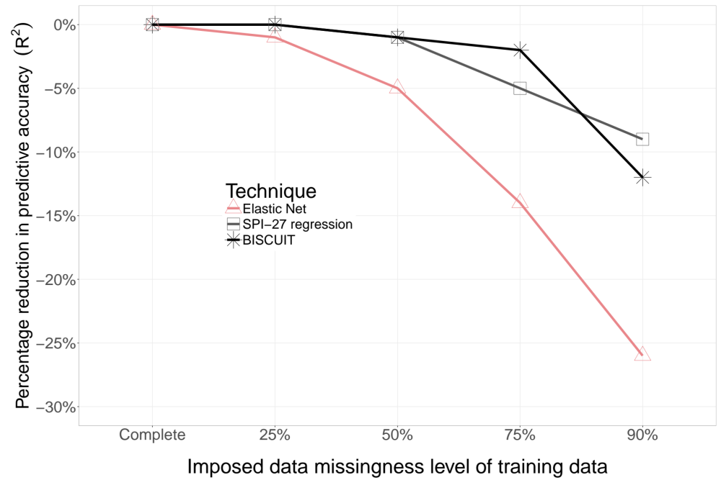
Post-hoc analysis: Loss in predictive accuracy
135 items
15 items
27 items

Slide 36
Common features of SL
Often, SL techniques modify traditional techniques (e.g,. regression). Here are four common SL modifications:
  Regularization: “Penalize” coefficients by shrinking them.
  Variable selection: Retain only the most important variables.
  Resampling: Iteratively train different models on subsamples of the training data and select the best model or an average model.
    (This mimics the train-test procedure.)
  Tuning parameter(s): Find the optimal values for certain parameters (via resampling).

Slide 37
Lasso
Regression-based
    Explicit regularization: uses a penalty parameter.
    Functional variable selection: some coefficients are penalized to zero.
    Resampling: the best model is selected.
    Tuning parameter: regularization penalty.

Slide 38
Elastic Net
Regression-based; more complex form of the lasso.
    Additional tuning parameter: the extent to which groups of highly inter-correlated variables will be retained.

Slide 39
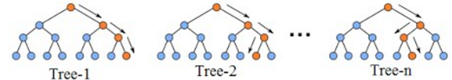

Random Forest
Decision tree-based
    No regularization.
    No variable selection: samples ⅓ of all variables in each tree; may or may not use all variables in the final model.
    Resampling: An average model is taken from many trees.
    No tuning parameter; no consensus in literature on what tuning parameters should be used (Probst & Boulesteix, 2018; Tang, Garreau, & von Luxburg, 2018).

Slide 40
Baseline technique: Regression
Using the Big Five and the SPI-27 (Condon, 2018).
    No regularization.
    No variable selection.
    No resampling.
    No tuning parameter.

Slide 41
Predictive accuracy: SPI-27 regression
SPI-27 regression’s relative predictive accuracy increased as data missingness increased. On average, compared to the most predictive model, regression using the SPI-27 was:
Complete data: 81% as predictive
25% data missingness: 87% as predictive
50% data missingness: 93% as predictive
75% data missingness: 95% as predictive
90% data missingness: 98% (best models for four criteria)

